Slide 1

Formatando
strings

Slide 2
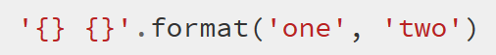
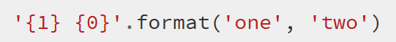
Básico

Slide 3
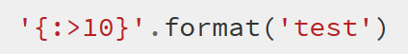
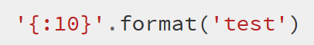
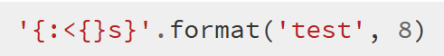
Padding e aligning strings
Alinhando a direita
Alinhando a esquerda
Com argumentos

Slide 4
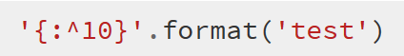
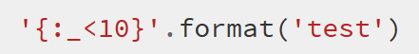
Padding e aligning strings
Alinhando ao centro
Passando um caracter para preenchimento

Slide 5
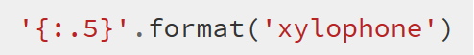
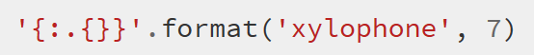
Truncate
Delimitando o tamanho
Com argumentos

Slide 6
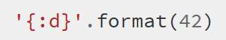
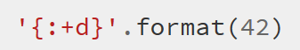
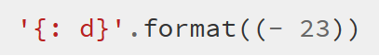
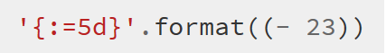
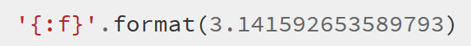
Números
Inteiros
Floats

Slide 7
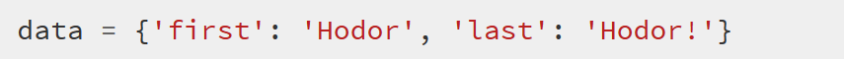

Objetos

Slide 8
Conversões
'b' Binary format. Outputs the number in base 2.
'c' Character. Converts the integer to the corresponding unicode character before printing.
'd' Decimal Integer. Outputs the number in base 10.
'o' Octal format. Outputs the number in base 8.
'x' Hex format. Outputs the number in base 16, using lower- case letters for the digits above 9.
'X' Hex format. Outputs the number in base 16, using upper- case letters for the digits above 9.
'n' Number. This is the same as 'd', except that it uses the current locale setting to insert the appropriate number separator characters.
None The same as 'd'.

